Slide 1
R Project Presentation and analysis
Topic: Titanic train dataset
Name: Harsh Pramodh

Slide 2
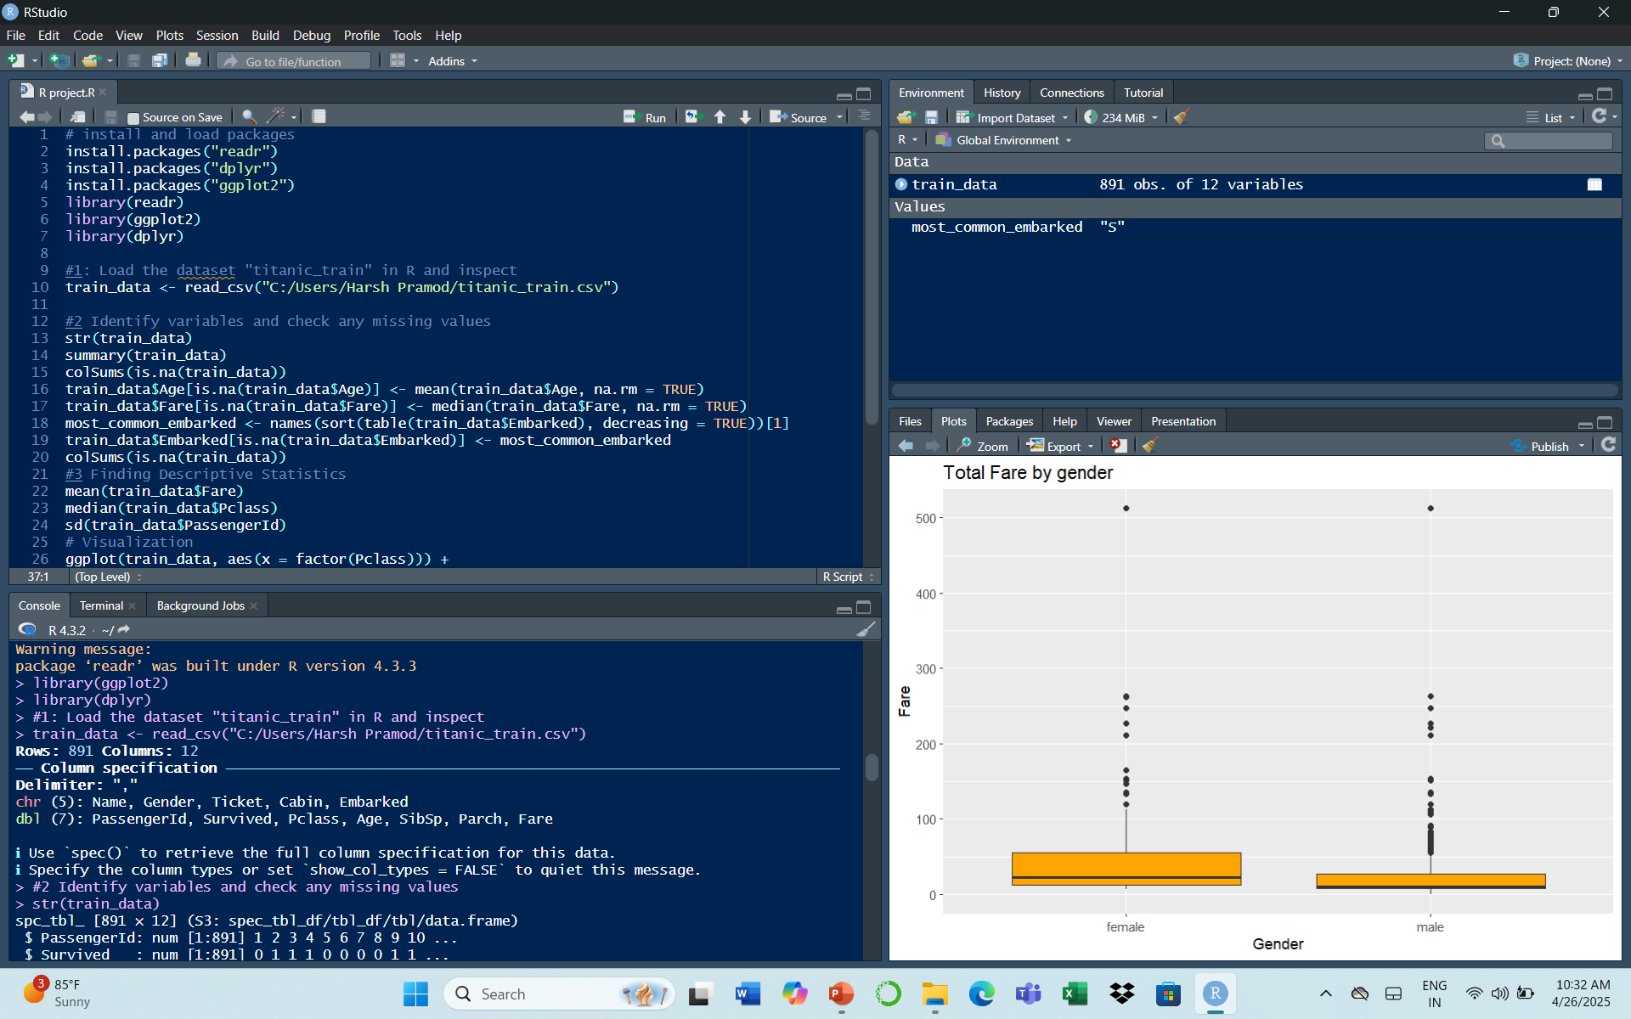
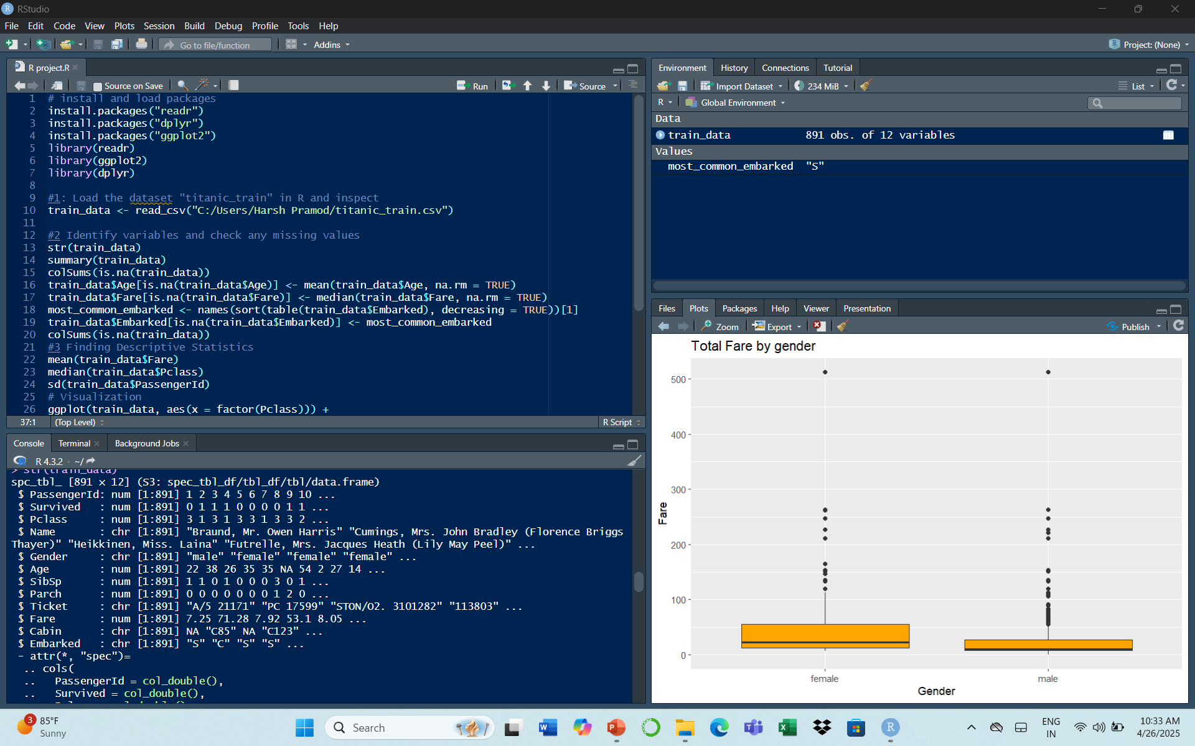
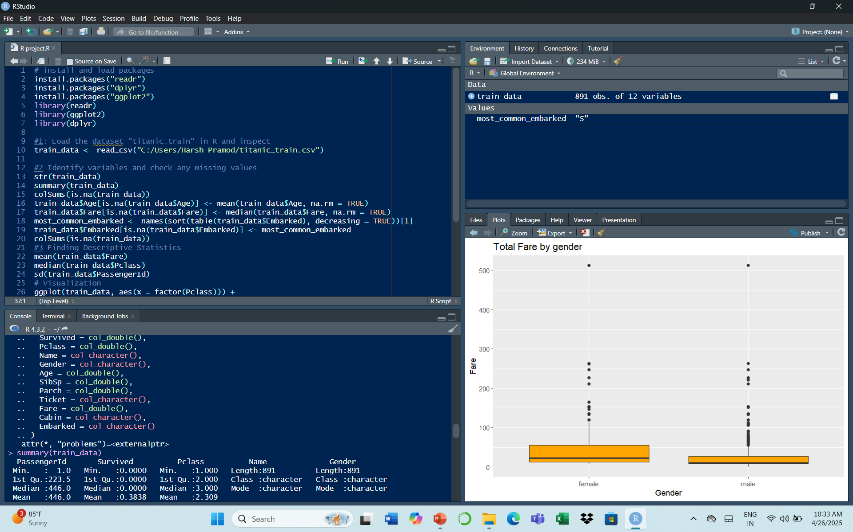
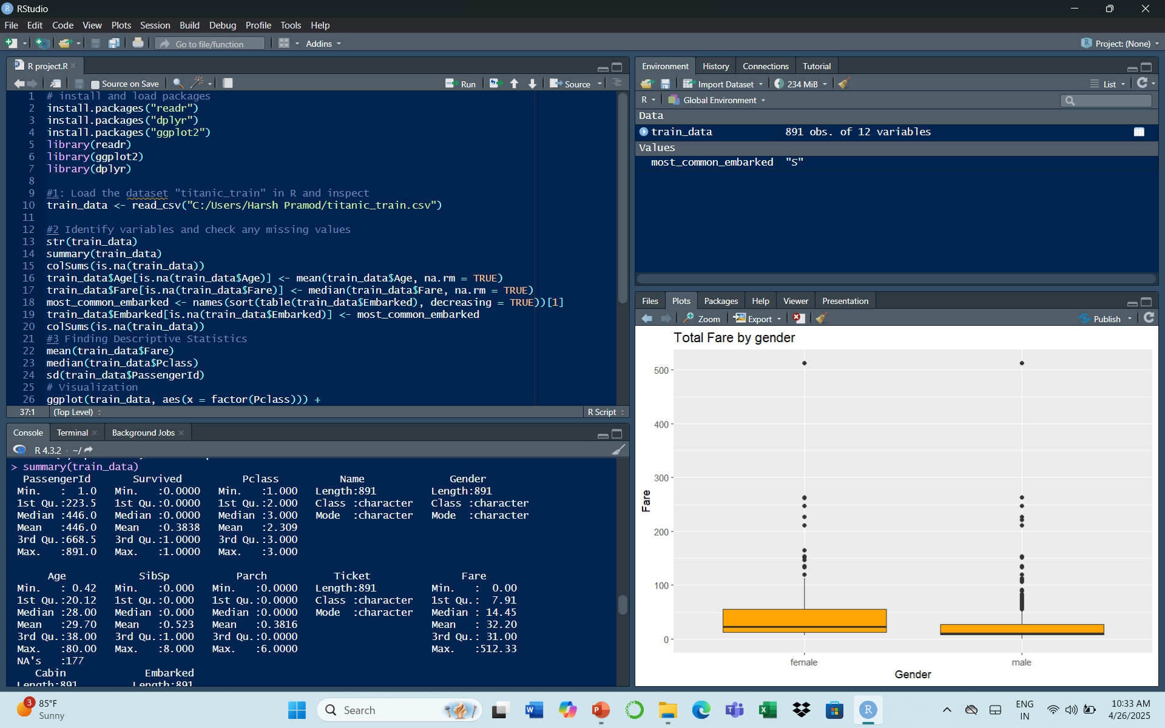

Slide 3
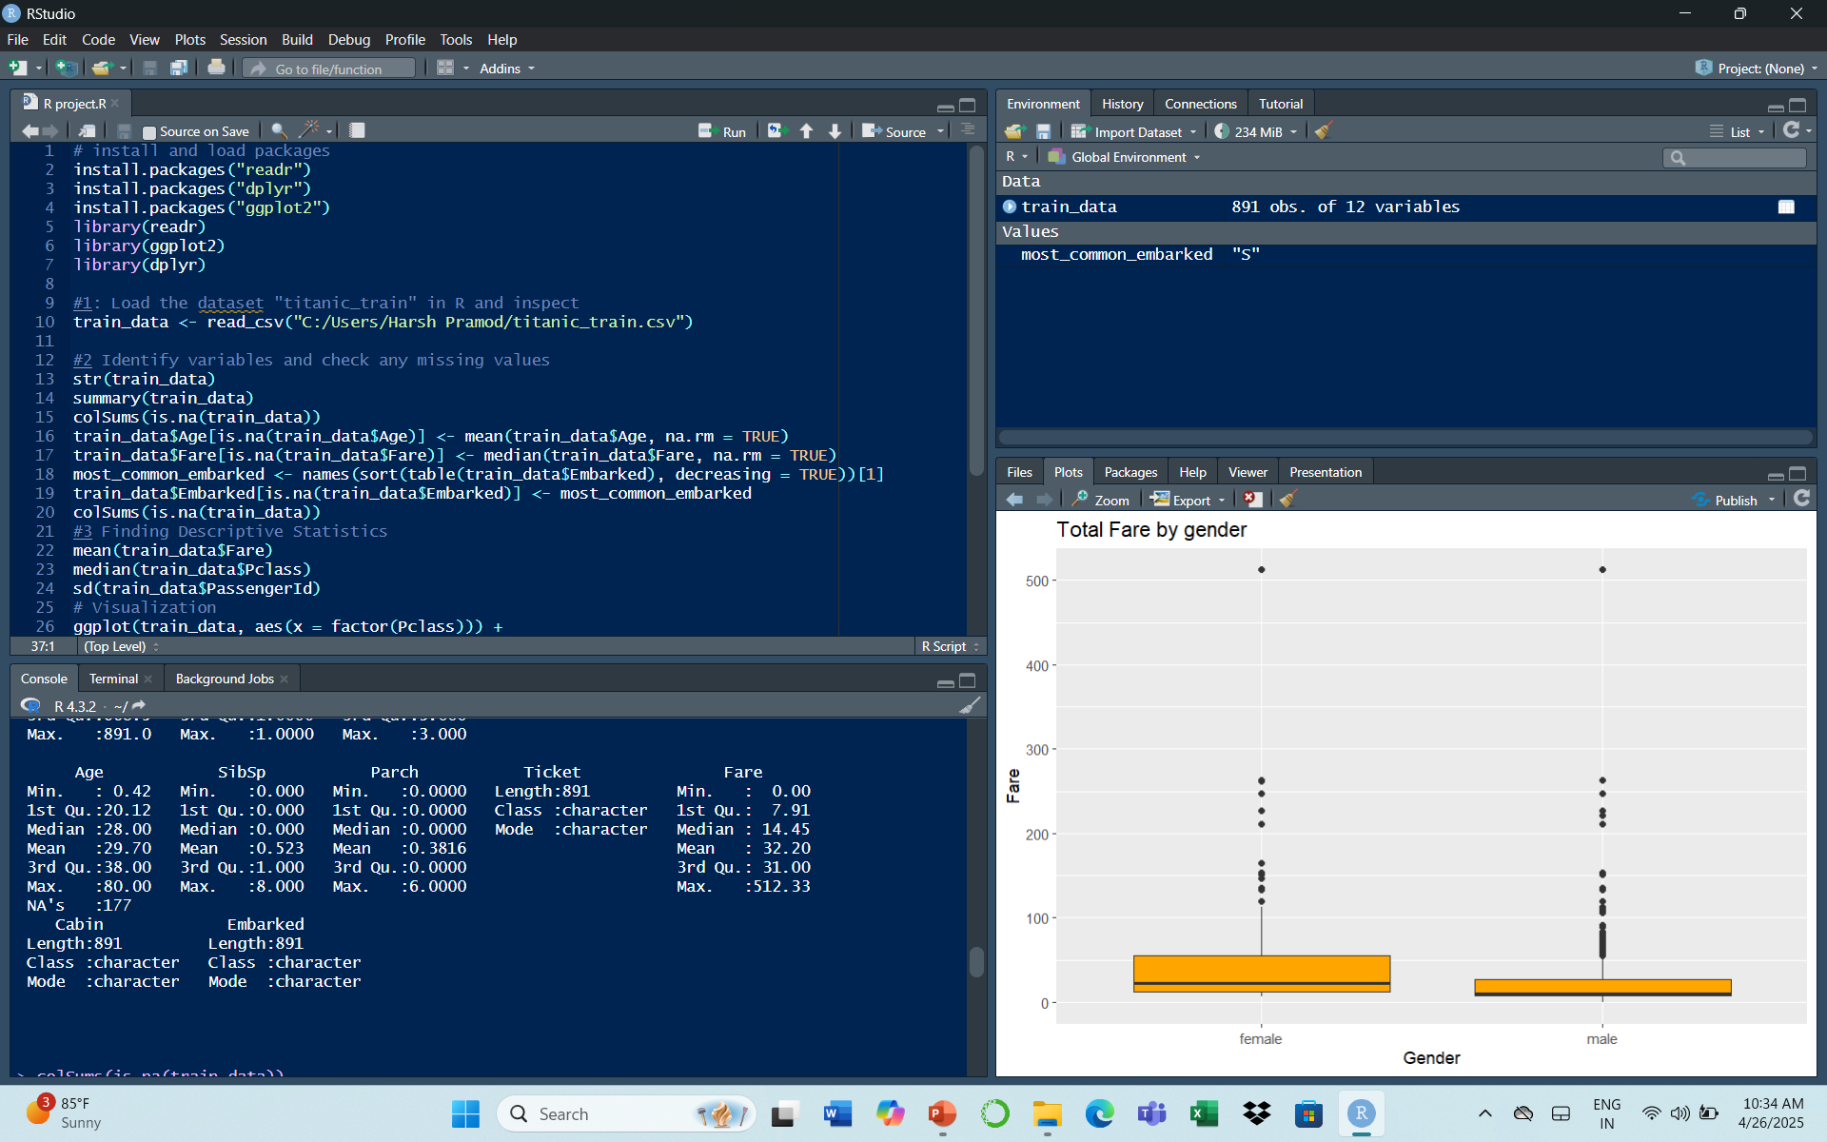
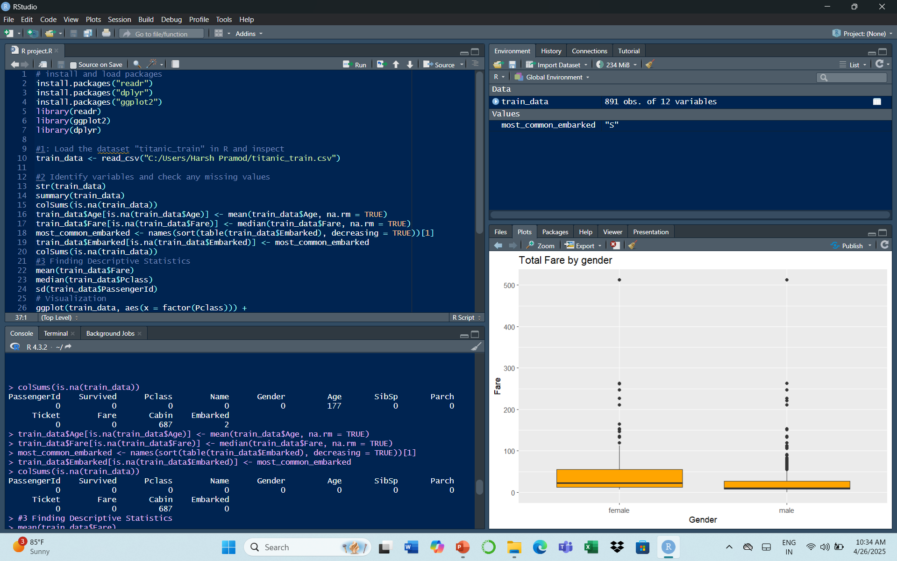
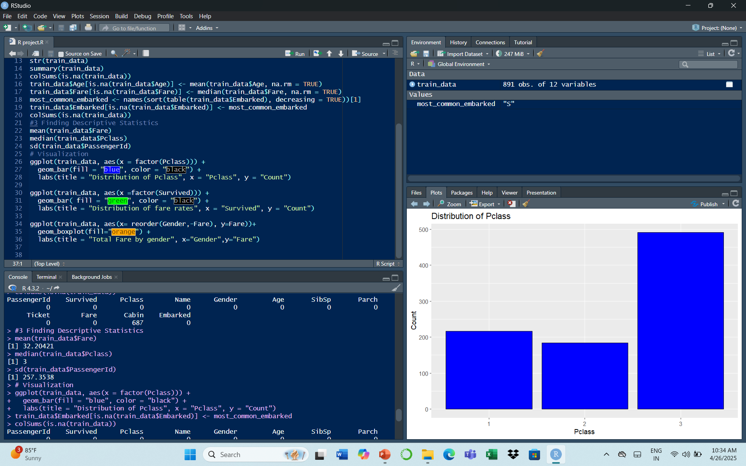

Slide 4
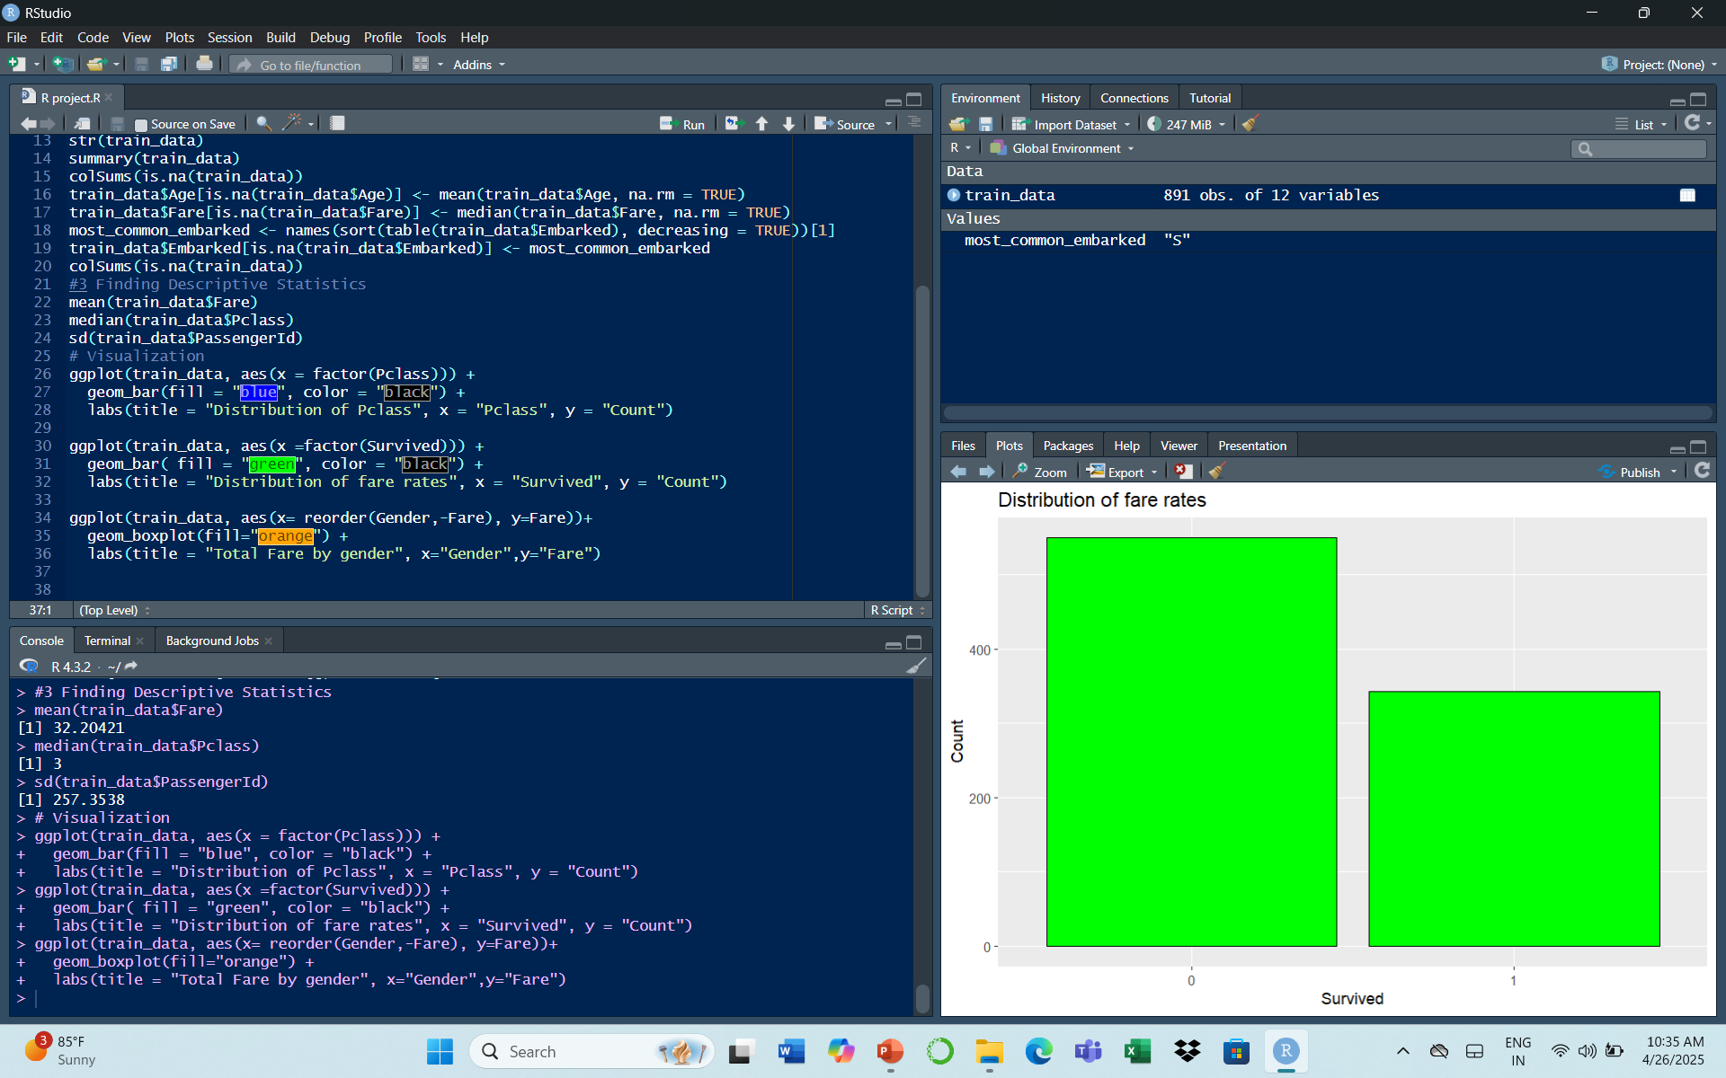
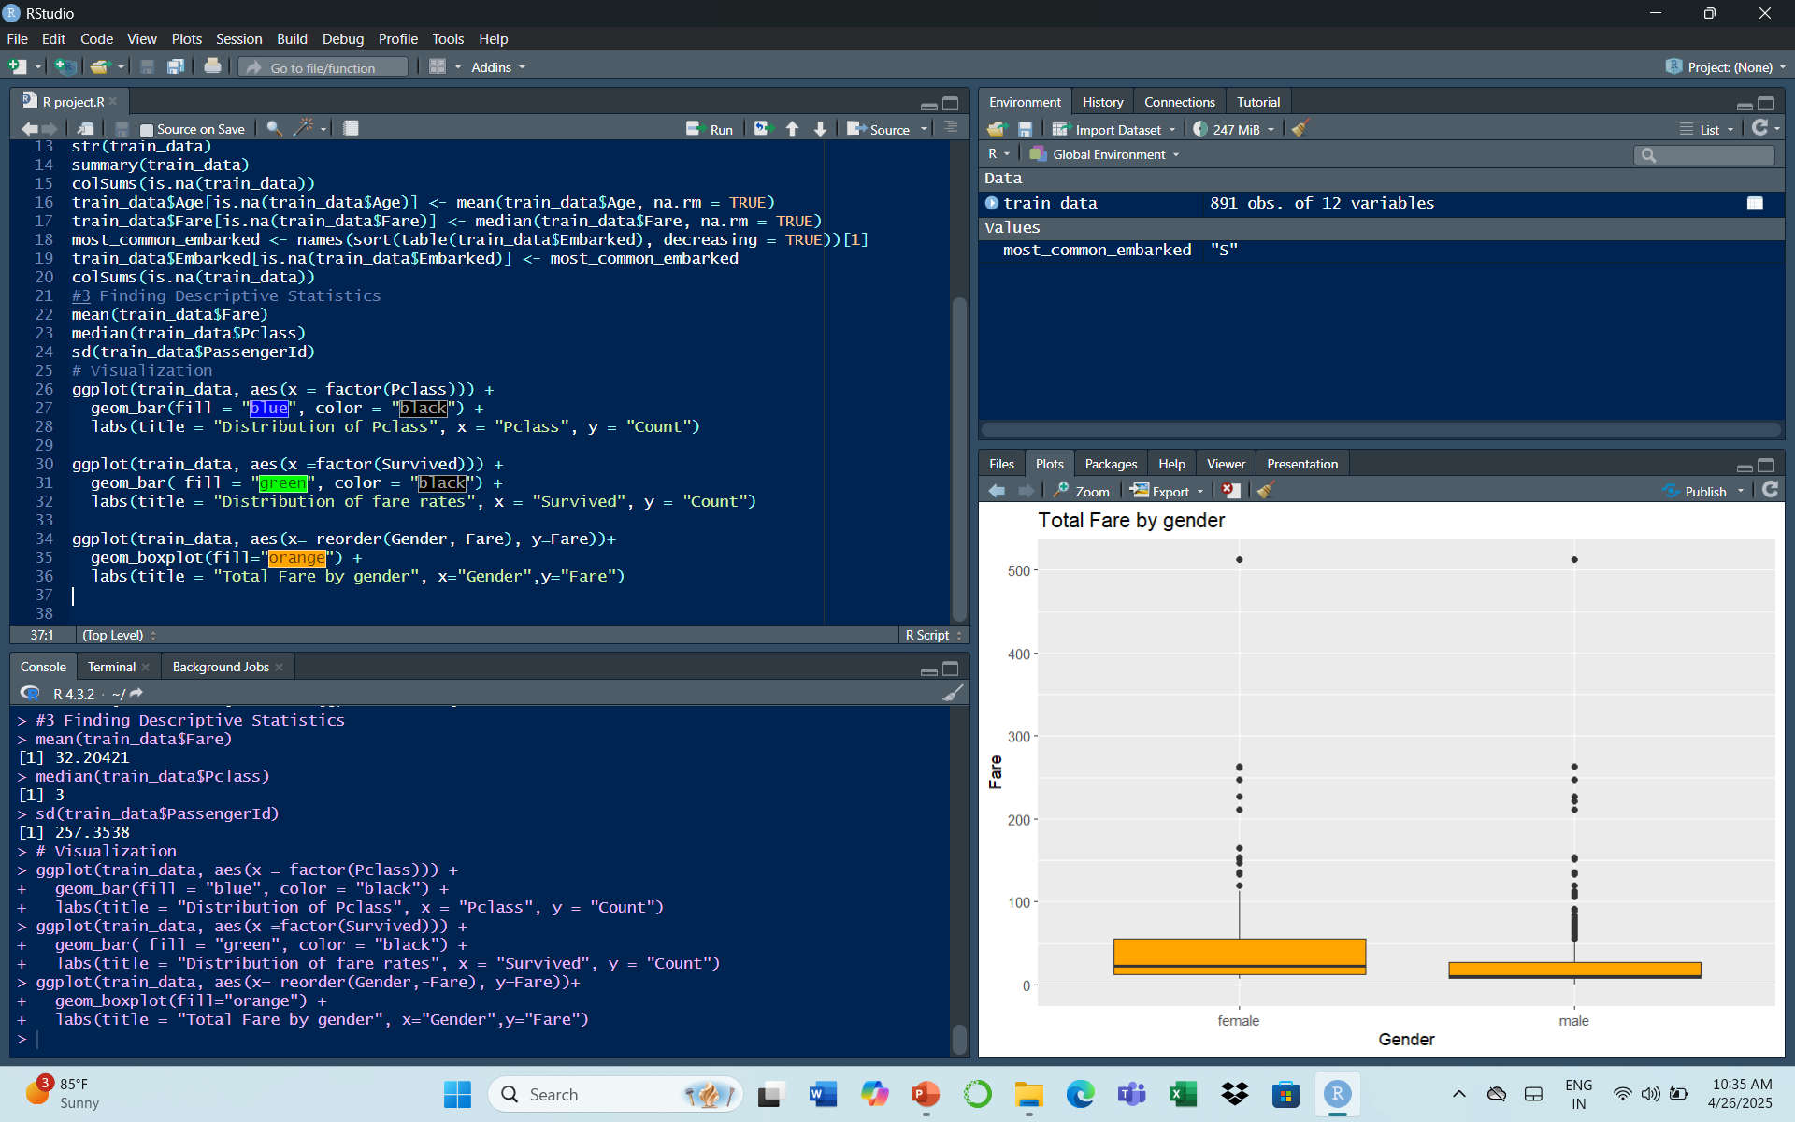

Slide 5
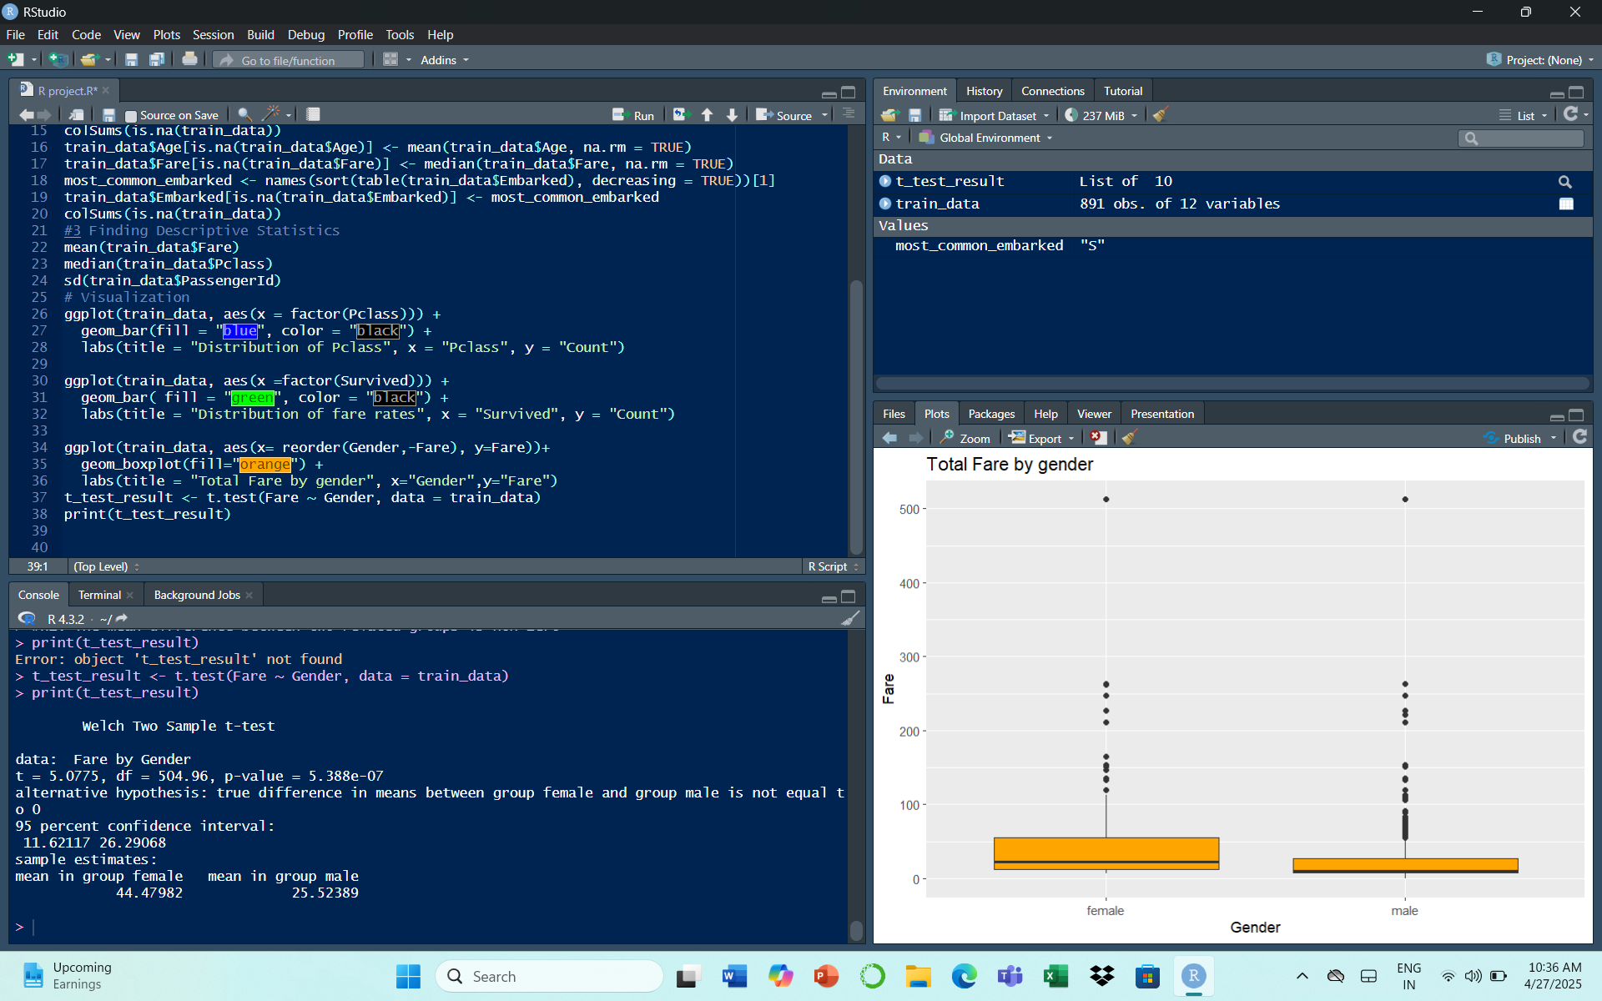

Slide 6
The p-value is much less than 0.05, so the difference is statistically significant.
On average, females paid higher fares than males.
We are 95% confident that the true mean fare difference between females and males lies between 11.62 and 26.29 units.
In short:
There is strong evidence that females paid significantly higher fares than males in this dataset.

